Slide 1
Institute for Cyber Security
The Future of Access Control:
Attributes, Automation and Adaptation
Prof. Ravi Sandhu
Executive Director and Endowed Chair
SERE
NIST, Gaithersberg
June 19, 2013
ravi.sandhu@utsa.edu
www.profsandhu.com
www.ics.utsa.edu
© Ravi Sandhu
World-Leading Research with Real-World Impact!

Slide 2
Prognosis: Cyberspace
Cyberspace will become orders of magnitude more complex and confused very quickly
Overall this is a very positive development and will enrich human society
It will be messy but need not be chaotic!
Cyber security research and practice are loosing ground
© Ravi Sandhu
World-Leading Research with Real-World Impact!
2

Slide 3
Microsec vs Macrosec
© Ravi Sandhu
World-Leading Research with Real-World Impact!
3
Most cyber security thinking is microsec
Most big cyber security threats are macrosec
Microsec
  Retail attacks vs Targeted attacks
  99% of the attacks are thwarted by basic hygiene and some luck
  1% of the attacks are difficult and expensive, even impossible, to defend or detect
Rational microsec behavior can result in highly vulnerable macrosec

Slide 4
Cyber Security Goal
Enable system designers and operators to say:
This system is secure
There is an infinite supply of low-hanging attacks
Not attainable
© Ravi Sandhu
World-Leading Research with Real-World Impact!
4

Slide 5
Cyber Security Goal
Enable system designers and operators to say:
This system is secure enough
Mass scale, not very high assurance
  ATM network
  On-line banking
  E-commerce
One of a kind, extremely high assurance
  US President’s nuclear football
Many successful examples
© Ravi Sandhu
World-Leading Research with Real-World Impact!
5

Slide 6
Cyber Security Paradox
Our successes are not studied as success stories
Our successes are not attainable via current cyber security science, engineering, doctrine
© Ravi Sandhu
World-Leading Research with Real-World Impact!
6

Slide 7
Cyber Security
Cyber Security is all about
  tradeoffs and adjustments
  automation (in future)
Productivity
Security
Let’s build it
Cash out the benefits
Next generation can secure it
Let’s not build it
Let’s bake in super-security to
make it unusable/unaffordable
Let’s sell unproven solutions
There is a sweet spot in the middle
We don’t know how to predictably find it
and maintain position there
© Ravi Sandhu
World-Leading Research with Real-World Impact!
7

Slide 8
Prognosis: Access Control
Discretionary Access Control (DAC), 1970
Mandatory Access Control (MAC), 1970
Role Based Access Control (RBAC), 1995
Attribute Based Access Control (ABAC), ????
© Ravi Sandhu
World-Leading Research with Real-World Impact!
8

Slide 9
Prognosis: Access Control
Fixed
policy
Discretionary Access Control (DAC), 1970
Mandatory Access Control (MAC), 1970
Role Based Access Control (RBAC), 1995
Attribute Based Access Control (ABAC), ????
Flexible
policy
© Ravi Sandhu
World-Leading Research with Real-World Impact!
9

Slide 10
Prognosis: Access Control
Human
Driven
Discretionary Access Control (DAC), 1970
Mandatory Access Control (MAC), 1970
Role Based Access Control (RBAC), 1995
Attribute Based Access Control (ABAC), ????
Automated
Adaptive
© Ravi Sandhu
World-Leading Research with Real-World Impact!
10

Slide 11
Prognosis: Access Control
Discretionary Access Control (DAC), 1970
Mandatory Access Control (MAC), 1970
Role Based Access Control (RBAC), 1995
Messy or Chaotic?
Attribute Based Access Control (ABAC), ????
© Ravi Sandhu
World-Leading Research with Real-World Impact!
11

Slide 12
Cyber Security Technologies
AUTHENTICATION
RISK
ANALYSIS
ASSURANCE
CRYPTOGRAPHY
ACCESS
CONTROL
INTRUSION
DETECTION
AND AUDIT
SECURITY ENGINEERING
& MANAGEMENT
© Ravi Sandhu
World-Leading Research with Real-World Impact!
12

Slide 13
Access Control Limitations
Analog Hole
Inference
Covert Channels
Side Channels
Phishing
Safety
Usability
Privacy
Attack Asymmetry
Compatibility
Federation
….
© Ravi Sandhu
World-Leading Research with Real-World Impact!
13

Slide 14
Access Control Limitations
Analog Hole
Inference
Covert Channels
Side Channels
Phishing
Safety
Usability
Privacy
Attack Asymmetry
Compatibility
Federation
….
Can manage Cannot eliminate
© Ravi Sandhu
World-Leading Research with Real-World Impact!
14

Slide 15
Access Control Models
Discretionary Access Control (DAC), 1970
  Owner controls access
  But only to the original, not to copies
  Grounded in pre-computer policies of researchers
Mandatory Access Control (MAC), 1970
  Synonymous to Lattice-Based Access Control (LBAC)
  Access based on security labels
  Labels propagate to copies
  Grounded in pre-computer military and national security policies
Role-Based Access Control (RBAC), 1995
  Access based on roles
  Can be configured to do DAC or MAC
  Grounded in pre-computer enterprise policies
Numerous other models but only 3 successes: SO FAR
© Ravi Sandhu
World-Leading Research with Real-World Impact!
15

Slide 16
The RBAC Story
NIST-ANSI
Standard
Adopted
NIST-ANSI
Standard Proposed
RBAC96
model
© Ravi Sandhu
World-Leading Research with Real-World Impact!
16

Slide 17
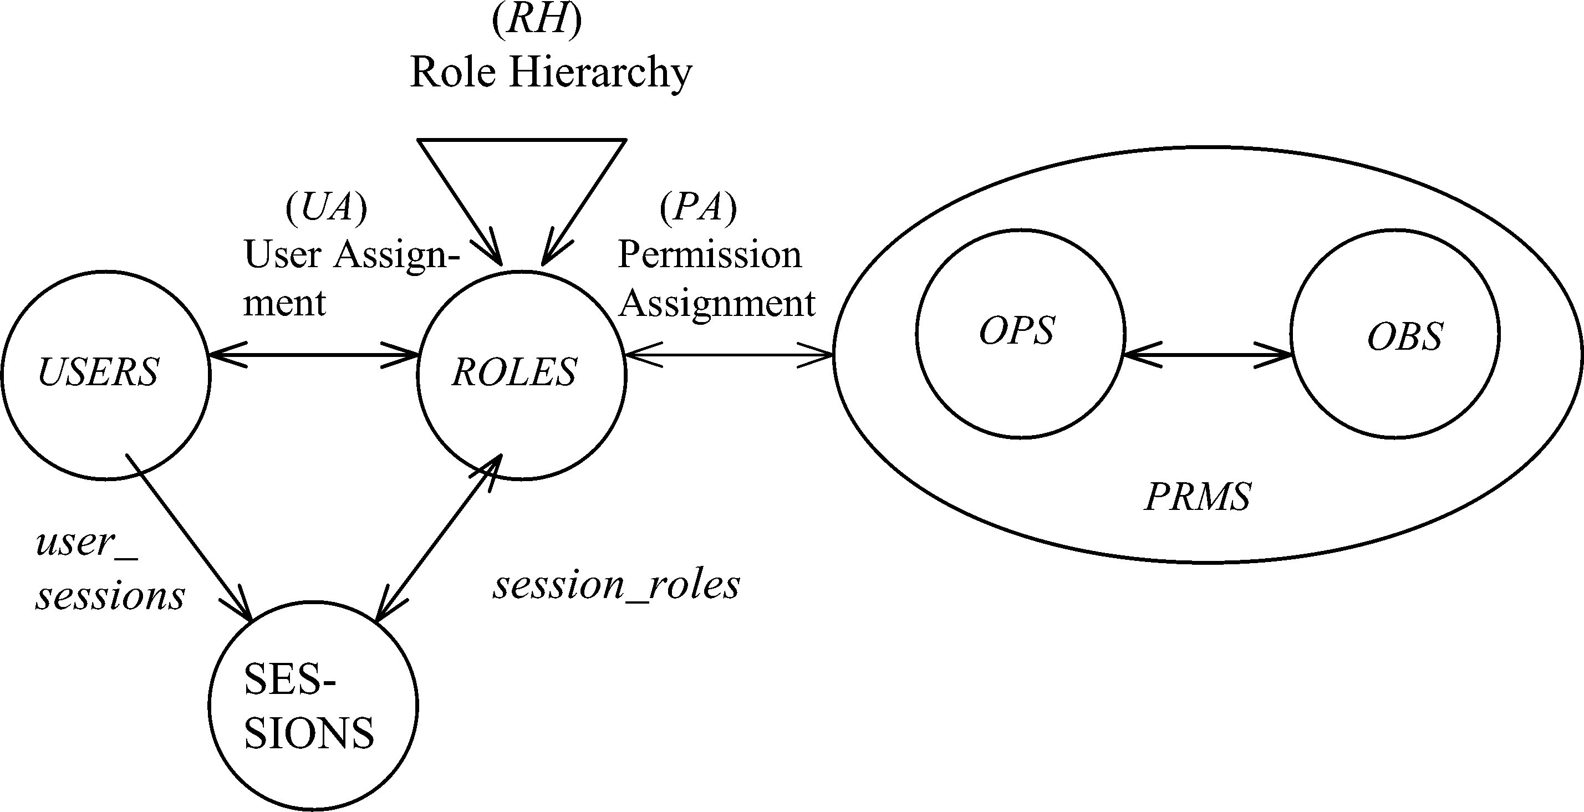
RBAC96 Model
Constraints
© Ravi Sandhu
World-Leading Research with Real-World Impact!
17

Slide 18
Fundamental Theorem of RBAC
  RBAC can be configured to do MAC
  RBAC can be configured to do DAC
  RBAC is policy neutral
RBAC is neither MAC nor DAC!
© Ravi Sandhu
World-Leading Research with Real-World Impact!
18

Slide 19
RBAC Shortcomings
Role granularity is not adequate leading to role explosion
  Researchers have suggested several extensions such as parameterized privileges, role templates, parameterized roles (1997-)
Role design and engineering is difficult and expensive
  Substantial research on role engineering top down or bottom up (1996-), and on role mining (2003-)
Assignment of users/permissions to roles is cumbersome
  Researchers have investigated decentralized administration (1997-), attribute-based implicit user-role assignment (2002-), role-delegation (2000-), role-based trust management (2003-), attribute-based implicit permission-role assignment (2012-)
Adjustment based on local/global situational factors is difficult
  Temporal (2001-) and spatial (2005-) extensions to RBAC proposed
RBAC does not offer an extension framework
  Every shortcoming seems to need a custom extension
  Can ABAC unify these extensions in a common open-ended framework?
© Ravi Sandhu
World-Leading Research with Real-World Impact!
19

Slide 20
RBAC Policy Configuration Points
Security Architect
Security
Administrator
Security
Administrator
Security
Architect
User
Security Architect
Constraints
Security Architect
© Ravi Sandhu
World-Leading Research with Real-World Impact!
20

Slide 21
Access Control Models
Policy
Specification
Policy
Enforcement
Policy
Reality
Policy
Administration
© Ravi Sandhu
World-Leading Research with Real-World Impact!
21

Slide 22
Access Control Models
Policy
Specification
Policy
Enforcement
RBAC, ABAC
Initial focus
Policy
Reality
MAC, DAC
focus
Policy
Administration
© Ravi Sandhu
World-Leading Research with Real-World Impact!
22

Slide 23
Attribute-Based Access Control (ABAC)
Attributes are name:value pairs
  possibly chained
  values can be complex data structures
Associated with
  users
  subjects
  objects
  contexts
    device, connection, location, environment, system …
Converted by policies into rights just in time
  policies specified by security architects
  attributes maintained by security administrators
  ordinary users morph into architects and administrators
Inherently extensible
© Ravi Sandhu
World-Leading Research with Real-World Impact!
23

Slide 24
ABAC Status
Standard
Adopted
Proposed
Standard
RBAC96
paper
1990?
2012
ABAC still in pre/early phase
© Ravi Sandhu
World-Leading Research with Real-World Impact!
24

Slide 25
ABAC Prior Work Includes
X.509, SPKI Attribute Certificates (1999 onwards)
  IETF RFCs and drafts
  Tightly coupled with PKI (Public-Key Infrastructure)
XACML (2003 onwards)
  OASIS standard
  Narrowly focused on particular policy combination issues
  Fails to accommodate the ANSI-NIST RBAC standard model
  Fails to address user subject mapping
Usage Control or UCON (Park-Sandhu 2004)
  Fails to address user subject mapping
  Focus is on extended features
    Mutable attributes
    Continuous enforcement
    Obligations
    Conditions
Several others ………..
© Ravi Sandhu
World-Leading Research with Real-World Impact!
25

Slide 26
ABACα Hypothesis (DBSEC 2012)
An ABAC model requires
  identification of policy configuration points (PCPs)
  languages and formalisms for each PCP
A core set of PCPs can be discovered by building the ABACα model to unify DAC, MAC and RBAC
Additional ABAC models can then be developed by
  increasing the sophistication of the ABACα PCPs
  discovering additional PCPs driven by requirements beyond DAC, MAC and RBAC
A small but crucial step
© Ravi Sandhu
World-Leading Research with Real-World Impact!
26

Slide 27
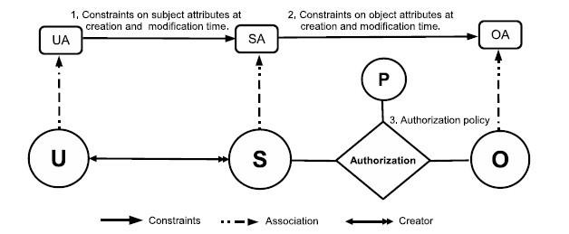
ABACα Model Structure
Policy Configuration Points
© Ravi Sandhu
World-Leading Research with Real-World Impact!
27

Slide 28
ABACα Model Structure
Policy Configuration Points
Can be configured to do DAC, MAC, RBAC
© Ravi Sandhu
World-Leading Research with Real-World Impact!
28

Slide 29
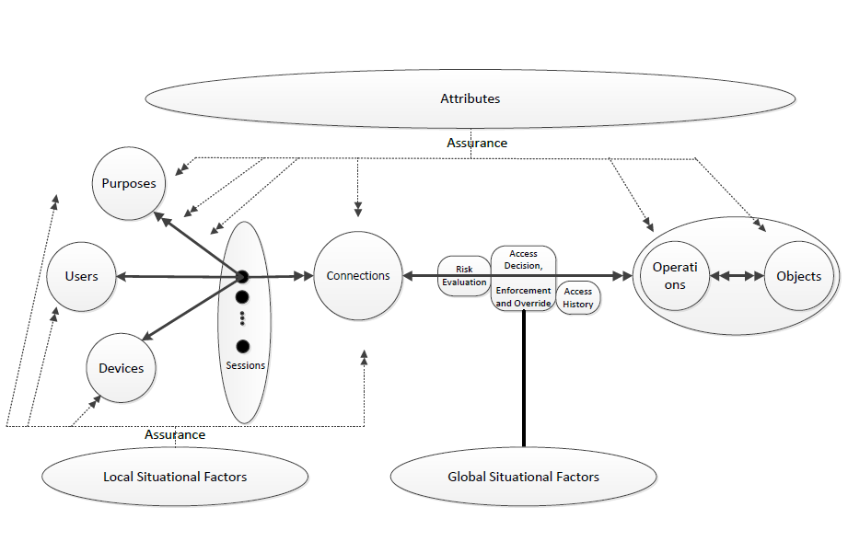
Risk Adaptive Access Control (RAdAC)
© Ravi Sandhu
World-Leading Research with Real-World Impact!
29

Slide 30
Authorization Leap
Rights to attributes
Rights
Labels
Roles
Attributes
Messy
??
Chaotic
Benefits
Decentralized
Dynamic
Contextual
Consolidated
Risks
Complexity
Confusion
Attribute trust
Policy trust
© Ravi Sandhu
World-Leading Research with Real-World Impact!
30

Slide 31
Prognosis: Cyber Security
Attributes
Automated
Adaptive
Managed but not solved
© Ravi Sandhu
World-Leading Research with Real-World Impact!
31

