Slide 1
Institute for Cyber Security
The Authorization Leap from Rights to Attributes:
Maturation or Chaos?
Prof. Ravi Sandhu
Executive Director and Endowed Chair
SACMAT
June 21, 2012
ravi.sandhu@utsa.edu
www.profsandhu.com
www.ics.utsa.edu
© Ravi Sandhu
World-Leading Research with Real-World Impact!

Slide 2
Access Control Status
Dozens of models proposed and studied. Only three winners (meaningful practical traction)
  DAC: Discretionary Access Control, 1970
  MAC: Mandatory Access Control, 1970
  RBAC: Role-Based Access Control, 1995
RBAC emerged at an inflection point due to dissatisfaction with the then dominant DAC and MAC
  We are currently at another inflection point due to dissatisfaction with the now dominant RBAC
  ABAC (Attribute-Based Access Control) has emerged as the prime candidate to be the next dominant paradigm
© Ravi Sandhu
World-Leading Research with Real-World Impact!
2

Slide 3
ABAC = Final Word?
NO!! Never!!
Is ABAC the right word for the moment?
  Certainly a strong candidate
  Already too late?
    ReBAC (relationship-based access control) not ABAC
    Big Data, Analytics and AI will take care of everything
ABAC is exponentially more complex than anything that has been an Access Control winner so far (DAC, MAC, RBAC)
  We need the complexity, but need to manage it
  If Google can index the web, we can do ABAC!!
© Ravi Sandhu
World-Leading Research with Real-World Impact!
3

Slide 4
Attribute-Based Access Control (ABAC)
Attributes are name:value pairs
  possibly chained
Associated with
  users
  subjects
  objects
  contexts
    device, connection, location, environment, system …
Converted by policies into rights just in time
  policies specified by security architects
  attributes maintained by security administrators
  ordinary users morph into architects and administrators
© Ravi Sandhu
World-Leading Research with Real-World Impact!
4

Slide 5
Authorization Leap
Rights to attributes
Rights
Labels
Roles
Attributes
Maturation
??
Chaos
Benefits
Decentralized
Dynamic
Contextual
Consolidated
Risks
Complexity
Confusion
Attribute trust
Policy trust
© Ravi Sandhu
World-Leading Research with Real-World Impact!
5

Slide 6
Prognosis
Cyber technologies and systems trends will drive pervasive adoption of ABAC
  RBAC is simply not good enough
ABAC deployment is going to be messy but need not be chaotic
Researchers can facilitate ABAC adoption and reduce chaos by developing
  Models
  Theories
  Systems
© Ravi Sandhu
World-Leading Research with Real-World Impact!
6

Slide 7
Authorization Challenges
Policy
Specification
Policy
Enforcement
Policy
Reality
Policy
Administration
© Ravi Sandhu
World-Leading Research with Real-World Impact!
7

Slide 8
Policy Reality
Analog Hole
Inference
Covert Channels
Side Channels
Spoofing
Attack Asymmetry
Compatibility
….
© Ravi Sandhu
World-Leading Research with Real-World Impact!
8

Slide 9
The RBAC Story
Standard
Adopted
Proposed
Standard
RBAC96
paper
© Ravi Sandhu
World-Leading Research with Real-World Impact!
9

Slide 10
ABAC Status
Standard
Adopted
Proposed
Standard
RBAC96
paper
1990?
2012
ABAC still in pre/early phase
© Ravi Sandhu
World-Leading Research with Real-World Impact!
10

Slide 11
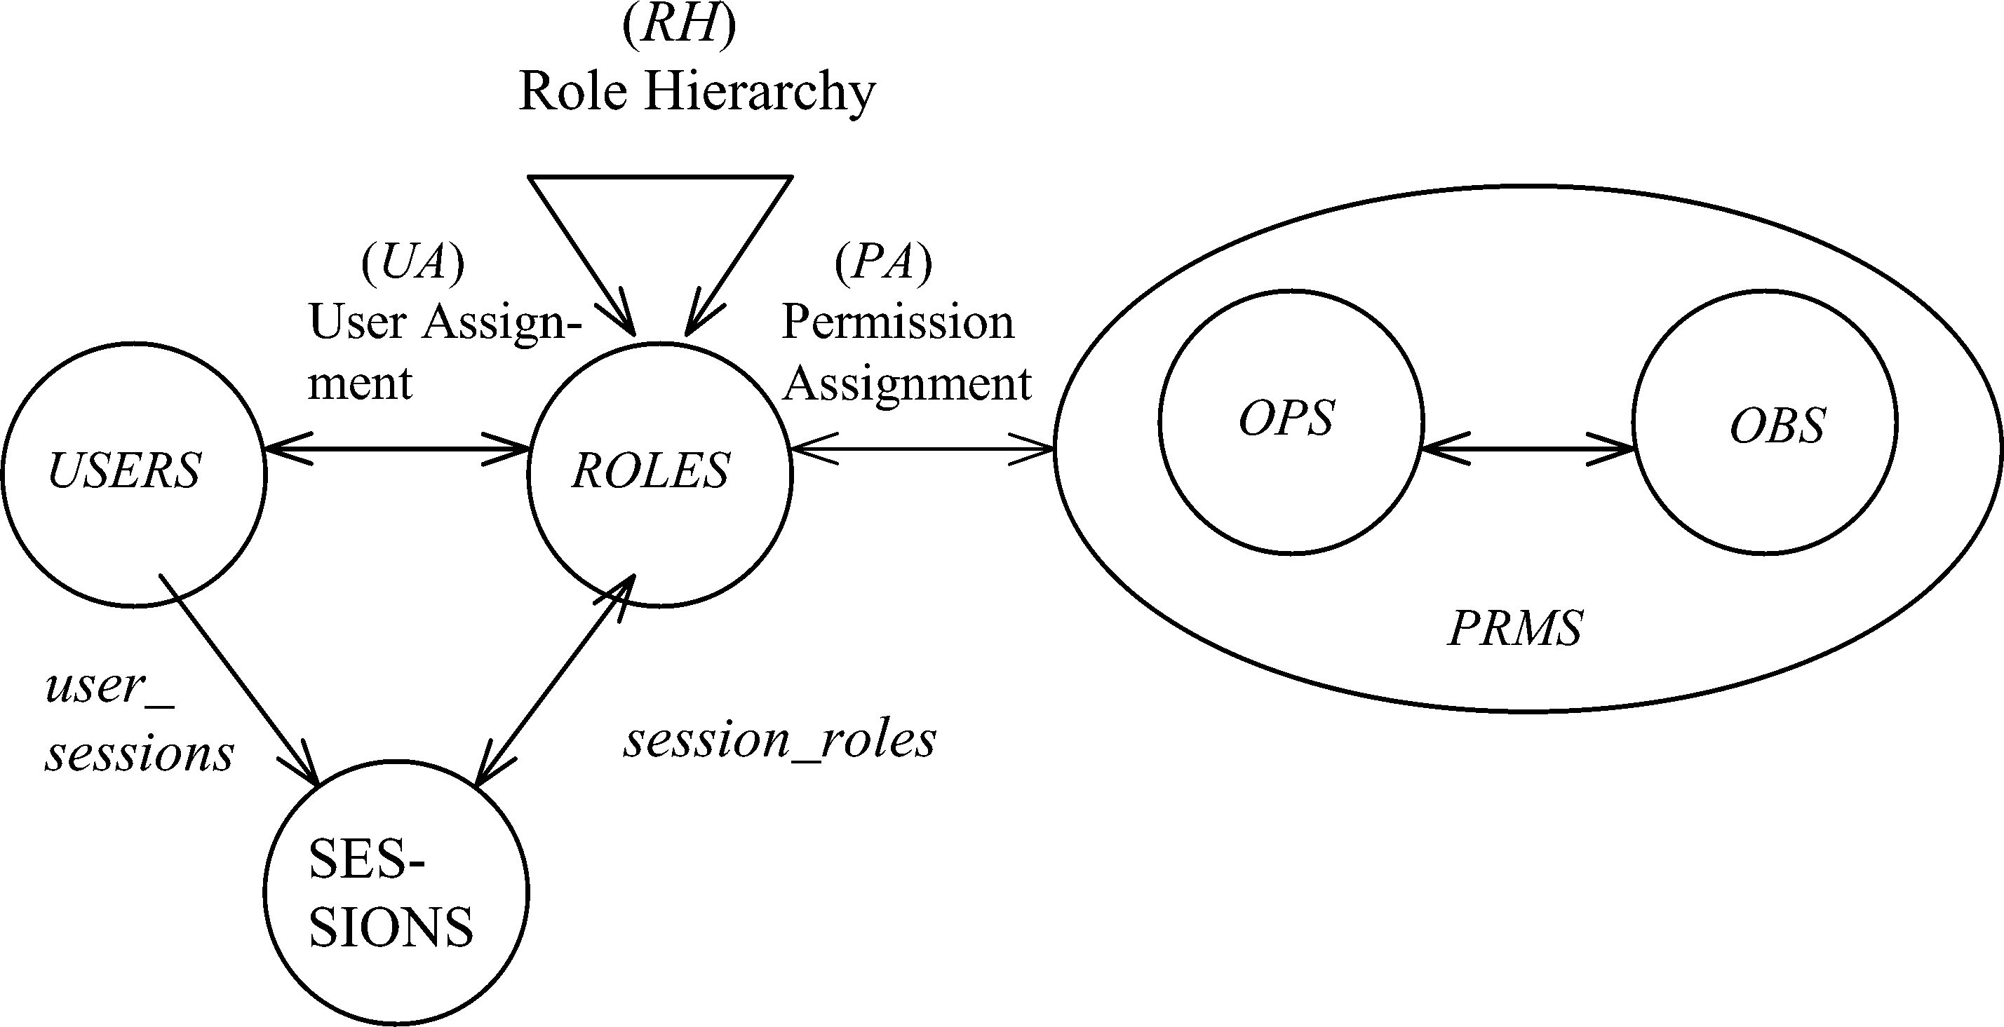
RBAC Policy Configuration Points
Role Hierarchy (RH)
Constraints
© Ravi Sandhu
World-Leading Research with Real-World Impact!
11

Slide 12
RBAC Policy Configuration Points
Security Architect
Role Hierarchy (RH)
Security
Administrator
Security
Administrator
Security
Architect
User
Security Architect
Constraints
Security Architect
© Ravi Sandhu
World-Leading Research with Real-World Impact!
12

Slide 13
RBAC Policy Configuration Points
NIST model limits constraints to Static and Dynamic Separation of Duties
© Ravi Sandhu
World-Leading Research with Real-World Impact!
13

Slide 14
ABAC Status
Standard
Adopted
Proposed
Standard
RBAC96
paper
1990?
2012
ABAC still in pre/early phase
© Ravi Sandhu
World-Leading Research with Real-World Impact!
14

Slide 15
ABAC Prior Work Includes
X.509, SPKI Attribute Certificates (1999 onwards)
  IETF RFCs and drafts
  Tightly coupled with PKI (Public-Key Infrastructure)
XACML (2003 onwards)
  OASIS standard
  Narrowly focused on particular policy combination issues
  Fails to accommodate the ANSI-NIST RBAC standard model
  Fails to address user subject mapping
Usage Control or UCON (Park-Sandhu 2004)
  Fails to address user subject mapping
  Focus is on extended features
    Mutable attributes
    Continuous enforcement
    Obligations
    Conditions
© Ravi Sandhu
World-Leading Research with Real-World Impact!
15

Slide 16
RBAC Overall Assessment
Role granularity is not adequate leading to role explosion
  Researchers have suggested several extensions such as parameterized privileges, role templates, parameterized roles (1997-)
Role design and engineering is difficult and expensive
  Substantial research on role engineering top down or bottom up (1996-), and on role mining (2003-)
Assignment of users/permissions to roles is cumbersome
  Researchers have investigated decentralized administration (1997-), attribute-based implicit user-role assignment (2002-), role-delegation (2000-), role-based trust management (2003-), attribute-based implicit permission-role assignment (2012-)
Adjustment based on local/global situational factors is difficult
  Temporal (2001-) and spatial (2005-) extensions to RBAC proposed
RBAC does not offer an extension framework
  Every shortcoming seems to need a custom extension
  Can ABAC unify these extensions in a common open-ended framework?
© Ravi Sandhu
World-Leading Research with Real-World Impact!
16

Slide 17
ABAC Research Agenda
7. ABAC Design and Engineering
3. Administrative
ABAC Models
4. Extended
ABAC Models
5. ABAC Policy Languages
6. ABAC Enforcement Architectures
2. Core ABAC Models
1. Foundational Principles and Theory
© Ravi Sandhu
World-Leading Research with Real-World Impact!
17

Slide 18
ABAC Research Agenda:
RBAC Inspiration
7. Design and Engineering:
Role engineering: Coyne (1996), Thomsen et al (1999), Epstein-Sandhu (2001), Strembeck (2005)
Role mining: Kuhlmann-Schimpf (2003), RoleMiner (2006, 2007), Minimal Perturbation (2008)
5. Policy Languages Constraints: RCL (2000), Jaeger-Tidswell (2001), Crampton (2003), ROWLBAC (2008)
User-role assignment:
RB-RBAC (2002), RT (2003)
3. Administrative Models: ARBAC97 (1997), RBDM (2000), RDM (2000), RB-RBAC (2002), ARBAC02 (2002), PBDM (2003) ARBAC07 (2007), SARBAC (2003, 2007)
4. Extended Models: TMAC (1997) Workflow (1999), T-RBAC (2000), OrBAC (2003), TRBAC (2001), RT (2003), GTRBAC (2005), GEO-RBAC (2005), P-RBAC (2007)
6. Enforcement Architectures: Ferraiolo et al (1999), OM-AM (2000), Park et al (2001), xoRBAC (2001), RCC (2003), RB-GACA (2005), XACML Profiles (2004, 2005, 2006)
2. Core Models: RBAC96 (1996), ANSI-NIST Standard (2000, 2004)
1. Foundational Principles and Theory
Principles: RBAC96 (1996), OM-AM (2000), NIST Standard (2000, 2004), PEI (2006), ASCAA (2008)
Theory: ATAM Simulation (1999), LBAC-DAC Simulations (2000), Li-Tripunitara (2006), Stoller et al (2006, 2007), Jha et al (2008)
NOTE: Only a small sampling of the RBAC literature is cited in this diagram
© Ravi Sandhu
World-Leading Research with Real-World Impact!
18

Slide 19
ABAC Research Agenda
7. ABAC Design and Engineering
3. Administrative
ABAC Models
4. Extended
ABAC Models
5. ABAC Policy Languages
6. ABAC Enforcement Architectures
2. Core ABAC Models
1. Foundational Principles and Theory
© Ravi Sandhu
World-Leading Research with Real-World Impact!
19

Slide 20
ABAC Research Agenda
7. ABAC Design and Engineering
3. Administrative
ABAC Models
4. Extended
ABAC Models
5. ABAC Policy Languages
6. ABAC Enforcement Architectures
2. Core ABAC Models
Initial Results
1. Foundational Principles and Theory
© Ravi Sandhu
World-Leading Research with Real-World Impact!
20

Slide 21
ABAC Core Models
Approach this challenge from several perspectives
Initial results on a bottom-up approach
ABACα model (DBSEC 2012)
  Just sufficient to cover the core of DAC, MAC and RBAC
  No extraneous features (however attractive and desirable)
ABACβ model (in progress)
  Grow ABACα to accommodate additional models, including numerous RBAC extensions and RBAC-related models (e.g. RT)
© Ravi Sandhu
World-Leading Research with Real-World Impact!
21

Slide 22
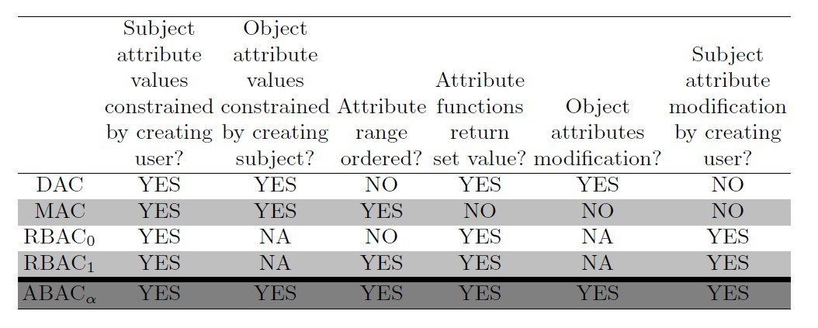
ABACα Requirements
© Ravi Sandhu
World-Leading Research with Real-World Impact!
22

Slide 23
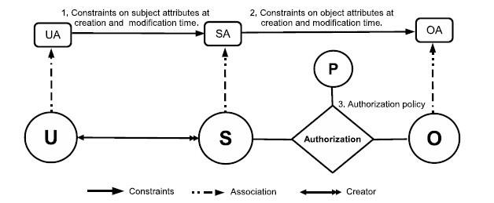
ABACα Model Structure
© Ravi Sandhu
World-Leading Research with Real-World Impact!
23

Slide 24
ABACα Model Structure
Policy Configuration Points
© Ravi Sandhu
World-Leading Research with Real-World Impact!
24

Slide 25
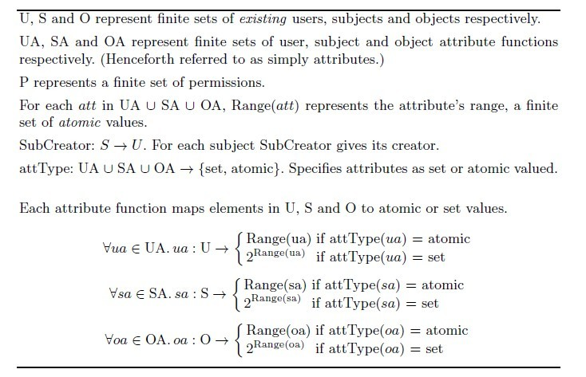
ABACα Basic Sets and Functions
© Ravi Sandhu
World-Leading Research with Real-World Impact!
25

Slide 26
ABACα Additional Components
Administrative Functions
  AddUser (u:NAME,uaset:UASET)
  DeleteUser (u:NAME)
  ModifyUserAtt (u:NAME,uaset:UASET)
System Functions
  CreateSubject (u; s:NAME,saset:SASET)
  DeleteSubject (u; s:NAME)
  ModifySubjectAtt (u; s:NAME,saset:SASET)
Review Functions
  UserAttributes (u:NAME)
  UserOperationsOnObject (u,o: NAME)
  AssignedUser(ua: NAME, value: Range(ua))
  UserPermissions(u: NAME)
  SubjectPermissions(s: NAME)
Policy Configuration Languages
© Ravi Sandhu
World-Leading Research with Real-World Impact!
26

Slide 27
ABACβ Model Structure
Policy Configuration Points
Same as ABACα
Enrich other ABACα Components
© Ravi Sandhu
World-Leading Research with Real-World Impact!
27

Slide 28
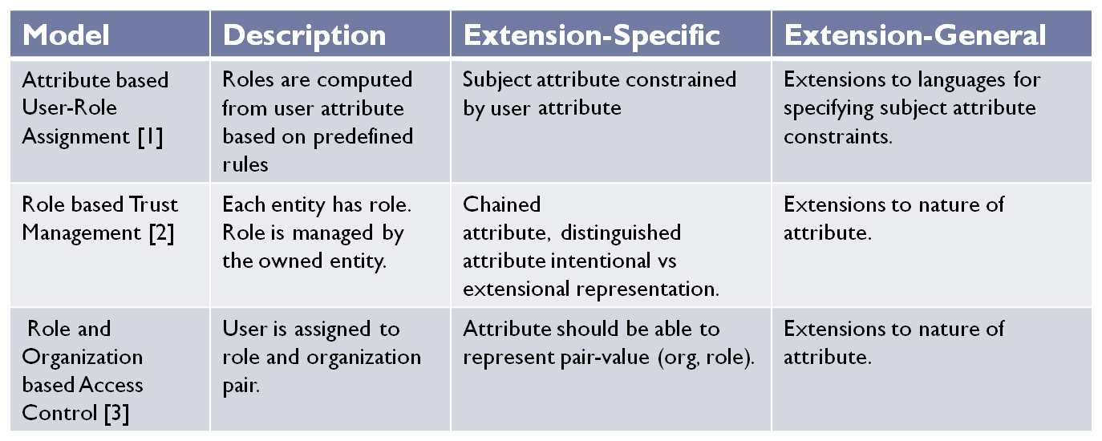
ABACβ Examples
[1]. MA Al-Kahtani and R. Sandhu. A model for attribute-based user-role assignment. ACSAC, 2002.
[2]. Ninghui Li, John C. Mitchell, and William H. Winsborough. Design of a role-based trust management framework. IEEE S&P 2002 .
[3]. Zhixiong Zhang, Xinwen Zhang and Ravi Sandhu, ROBAC: Scalable Role and Organization Based Access Control Models, TrustCol 2006
© Ravi Sandhu
World-Leading Research with Real-World Impact!
28

Slide 29
ABAC Research Agenda
7. ABAC Design and Engineering
3. Administrative
ABAC Models
4. Extended
ABAC Models
5. ABAC Policy Languages
6. ABAC Enforcement Architectures
2. Core ABAC Models
Initial Results
1. Foundational Principles and Theory
© Ravi Sandhu
World-Leading Research with Real-World Impact!
29

