Slide 1
Access Control Models for Virtual Object Communication in Cloud-Enabled IoT
Asma Alshehri and Ravi Sandhu
Institute for Cyber Security &
Department of Computer Science at UTSA
18th IEEE Conference on Information Reuse and Integration (IRI)
San Diego, California
August 4, 2017
nmt366@my.utsa.edu,
ravi.sandhu@utsa.edu
www.ics.utsa.edu
© Alshehri and Sandhu
World-Leading Research with Real-World Impact!

Slide 2

INTERNET OF THINGS
© Alshehri and Sandhu

Slide 3
GOAL
Develop an initial set of access control models for IoT within a robust framework.
© Alshehri and Sandhu
World-Leading Research with Real-World Impact!
3

Slide 4
ACCESS CONTROL ORIENTED (ACO) ARCHITECTURE FOR IOT
Figure 1. ACO Architecture for Cloud-Enabled IoT
[1] A. Alshehri and R. Sandhu, “Access control models for cloud-enabled internet of things: A proposed architecture and research agenda,” in the 2nd IEEE International Conference on Collaboration and Internet Computing (CIC). IEEE, 2016, pp. 530–538.
© Alshehri and Sandhu
World-Leading Research with Real-World Impact!
4

Slide 5
THE PAPER GOAL
* Develop access control models for VO communication in two layers:
    A - Operational models
    B - Administrative models
© Alshehri and Sandhu
World-Leading Research with Real-World Impact!
5

Slide 6
OUTLINE
Background
Use case within ACO architecture
Operational access control for VO communication
Administrative access control for VO communication
Current and future research
Conclusion
© Alshehri and Sandhu
World-Leading Research with Real-World Impact!
6

Slide 7
BACKGROUND
Access control models for IoT.
The publish and subscribe communication paradigm
* The publish/subscribe paradigm has various implementation, primarily topic-based and content-based.
© Alshehri and Sandhu
World-Leading Research with Real-World Impact!
7

Slide 8
USE CASE WITHIN ACO ARCHITECTURE
Figure 2. Sensing speeding cars within ACO Architecture
© Alshehri and Sandhu
World-Leading Research with Real-World Impact!
8

Slide 9
OPERATIONAL ACCESS CONTROL FOR
VO COMMUNICATION
ACL and Capability Based (ACL-Cap) Operational Model
ABAC Operational Model
Four Questions:
  Which VOs are allowed to publish or send a subscription request to a topic’s MB?
  Which MBs should VOs publish to or send a subscription request to?
  Which VOs should a topics MB forward data to?
  Which MBs should VOs receive data from?
© Alshehri and Sandhu
World-Leading Research with Real-World Impact!
9

Slide 10
A. ACL and Capability Based (ACL-Cap)
Operational Model
The operational models recognize sets of entities:
  Virtual objects (VO) and topics (T)
  A set of rights R={p,s}.
  F={Forward}
Figure 3. The ACL-Cap Model
© Alshehri and Sandhu
World-Leading Research with Real-World Impact!
10

Slide 11
A. ACL and Capability Based (ACL-Cap)
Operational Model
The authorization rule for publish is expressed as follows.
Auth-Publish(VO,T) ≡ (T,p) ∈ Cap(VO)∧ (VO, p) ∈ ACL(T)
The authorization rule for subscribe is expressed as follows.
Auth-Subscribe(VO,T) ≡ (T,s) ∈ Cap(VO)∧ (VO, s) ∈ ACL(T )
The authorization rule for forwarding of published data by a topic’s MB to a VO expressed as follows.
Auth-Forward(T, VO) ≡ VO ∈ Subscribers(T )∧T ∈ Subscriptions(VO)
Figure 3. The ACL-Cap Model
© Alshehri and Sandhu
World-Leading Research with Real-World Impact!
11

Slide 12
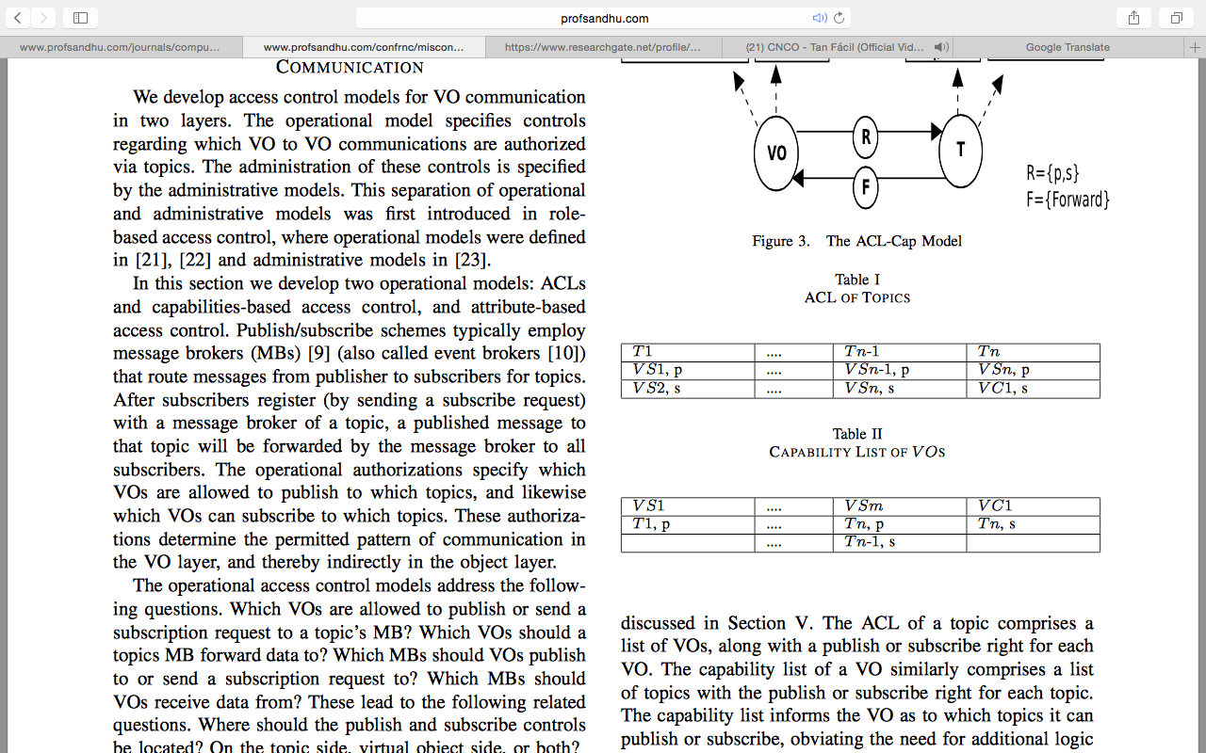
A. ACL and Capability Based (ACL-Cap)
Operational Model
The authorization rule for publish is expressed as follows.
Auth-Publish(VO,T) ≡ (T,p) ∈ Cap(VO)∧ (VO, p) ∈ ACL(T )
The authorization rule for subscribe is expressed as follows.
Auth-Subscribe(VO,T) ≡ (T,s) ∈ Cap(VO)∧ (VO, s) ∈ ACL(T )
The authorization rule for forwarding of published data by a topic’s MB to a VO expressed as follows.
Auth-Forward(T, VO) ≡ VO ∈ Subscribers(T )∧T ∈ Subscriptions(VO)
n
© Alshehri and Sandhu
World-Leading Research with Real-World Impact!
12

Slide 13
B. ABAC Operational Model
The operational models recognize sets of entities:
  Virtual objects (VO) and topics (T)
  A set of rights R={p,s} and F = {Forward}, as before
  Sets of attributes, virtual object attributes (VOA ) and topic attributes (TA) , as follows.
  VOA = {VO-Publish, VO-Subscribe, VO-Subscriptions, VO-Location}
  TA= {T-Publish, T-Subscribe, T-Subscribers, T-Location}
Figure 4. ABAC Operational Model
© Alshehri and Sandhu
World-Leading Research with Real-World Impact!
13

Slide 14
B. ABAC Operational Model
The authorization rule for publish is expressed as follows.
Auth-Publish(VO,T) ≡ T ∈ VO-Publish(VO)∧VO ∈ T-Publish(T)
The authorization rule for subscribe is expressed as follows.
Auth-Subscribe(VO,T) ≡ T ∈ VO-Subscribe(VO)∧VO ∈ T-Subscribe(T)
The authorization rule for forwarding of published data by a topic’s MB to a VO expressed as follows.
Auth-Forward(T, VO) ≡ T ∈ Subscriptions(VO)∧VO ∈ Subscribers(T )
We can conjunctively add the following condition to each of the three equations above.
T-Location(T) ≈ VO-Location(VO)
Figure 4. ABAC Operational Model
© Alshehri and Sandhu
World-Leading Research with Real-World Impact!
14

Slide 15
ADMINISTRATIVE ACCESS CONTROL FOR
VO COMMUNICATION
Admins mean users who are authorized to control VO communication, by adjusting configuration of the operational model.
  Administrative ACL Model
  Administrative RBAC Model
  Administrative ABAC Model
For the ACL-Cap operational model:
Who is allowed to add or delete (VO,p) or (VO,s) from ACL of T?
Who is allowed to add or delete (T,p) or (T,s) from Capability list of VO?
For the ABAC operational model:
Who is allowed to assign or delete values to/from attributes of T?
Who is allowed to assign or delete values to/from attributes of VO?
© Alshehri and Sandhu
World-Leading Research with Real-World Impact!
15

Slide 16
  A. Administrative ACL Model
The administrative ACL model introduces a set of admin users (A) and admin permissions (AP) as follows.
A = {U1, .., Um-1, Um}
AP = {Own, Control}
Figure 5. Administrative ACL
© Alshehri and Sandhu
World-Leading Research with Real-World Impact!
16

Slide 17
  A. Administrative ACL Model
The authorization rule for admin user U to control T or VO as follow.
Auth-Control(U,T) ≡ (U,ap) ∈ ACL(T)
Auth-Control(U,VO) ≡ (U,ap) ∈ ACL(VO)
Figure 5. Administrative ACL
© Alshehri and Sandhu
World-Leading Research with Real-World Impact!
17

Slide 18
  B. Administrative RBAC Model
Additionally, RBAC introduces set of administrative roles (AR) and admin permissions (AP) as follows.
AR = {AR1, .., ARs},
AP =(VO×AP)∪ (T×AP)
Figure 6. Administrative RBAC
© Alshehri and Sandhu
World-Leading Research with Real-World Impact!
18

Slide 19
  C. Administrative ABAC Model
Additionally, ABAC introduces administrative attributes for topics (TAA), VOs (VOAA), and users (UAA), as follows.
TAA = {T-Location, T-Department}
VOAA = {VO-Type, VO-Location, VO-Department}
UAA = {U-Type, U-Location, U-Department}
Figure 9. Administrative ABAC
© Alshehri and Sandhu
World-Leading Research with Real-World Impact!
19

Slide 20
  C. Administrative ABAC Model
The authorization to use the Control permission with respect to virtual objects or topics is specified as follows.
Auth-Control(U,VO) ≡
(U-Type(U) = Own∨ U-Type(U) = Control)∧
U-Department(U )= VO-Department(VO)∧
(VO-type = sensor∨ VO-type = camera)∧
U-location ≈ VO-Location(VO)
Auth-Control(U,T) ≡
(U-Type(U) = Own∨ U-Type(U) = Control)∧
U-Department(U) = T-Department(T)∧
U-location = T -Location(T )
© Alshehri and Sandhu
World-Leading Research with Real-World Impact!
20

Slide 21
CURRENT AND FUTURE REASEARCH
Current Research:
  Studying VO communication within AWS IoT.
  Studying the access control model of VO communication within AWS IoT
Future research:
  Proposing access control models for User and Virtual Object communication.
  Proposing access control models for data accumulated within Virtual objects and cloud services.
© Alshehri and Sandhu
World-Leading Research with Real-World Impact!
21

Slide 22
  CONCLUSION
* Develop access control models for VO communication in two layers:
    A - Operational models
    ACL and Capability Based (ACL-Cap) Operational Model
    ABAC Operational Model
    B - Administrative models
    Administrative ACL Model
    Administrative RBAC Model
    Administrative ABAC Model
© Alshehri and Sandhu
World-Leading Research with Real-World Impact!
22

Slide 23


