Slide 1
Institute for Cyber Security
Role and Attribute Based Collaborative Administration of Intra-Tenant Cloud IaaS
(Invited Paper)
Xin Jin, Ram Krishnan and Ravi Sandhu
Institute for Cyber Security
University of Texas at San Antonio
October 22–25, 2014
10th IEEE International Conference on Collaborative Computing: Networking, Applications and Worksharing
World-Leading Research with Real-World Impact!
1

Slide 2
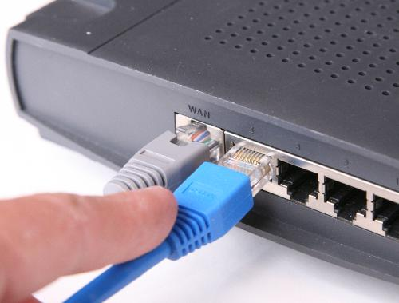
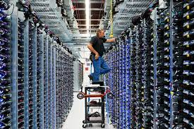
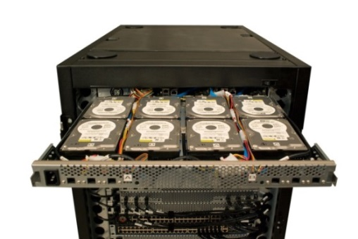
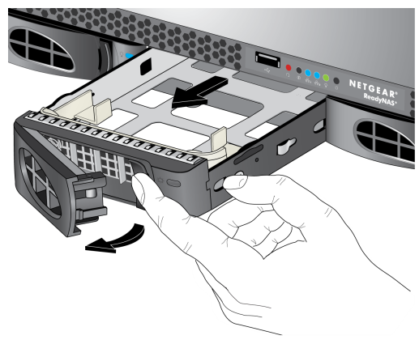
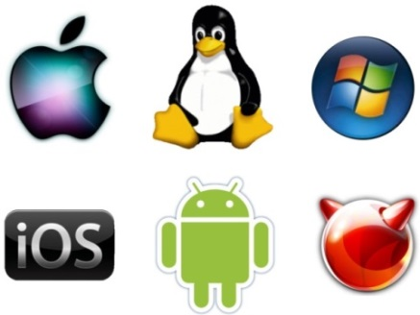
IT Infrastructure Operations
World-Leading Research with Real-World Impact!
2

Slide 3
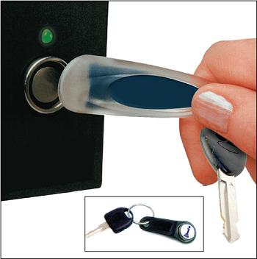
Access Control
World-Leading Research with Real-World Impact!
3

Slide 4
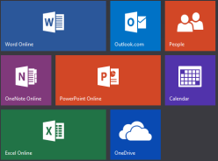
Cloud Service Models
Software as a Service (SaaS)
Network accessible software
Platform as a Service (PaaS)
App dev environment with cloud characteristics
Infrastructure as a Service (IaaS)
Virtualized hardware infrastructure

Slide 5
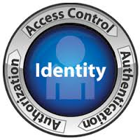
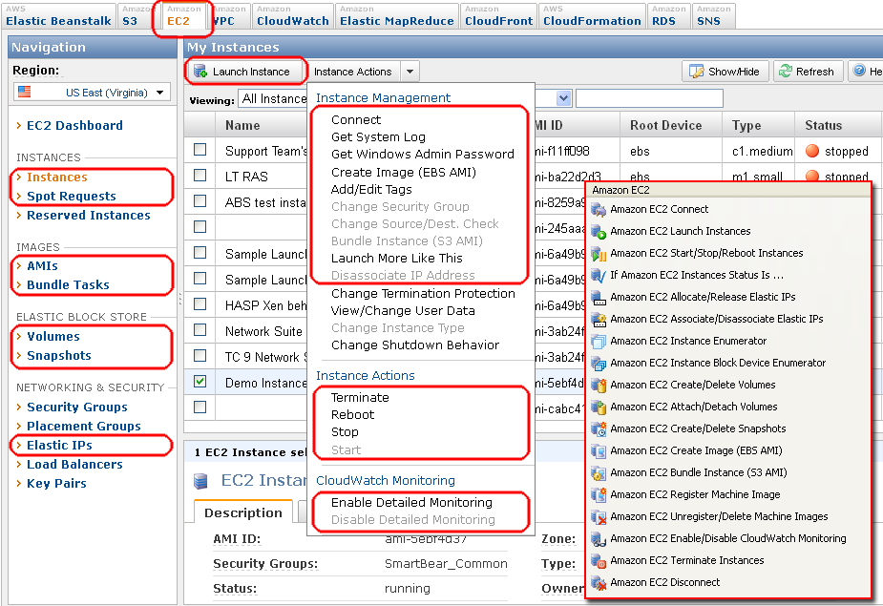
“Moving” to Cloud
Equivalent policies should be configurable using cloud access control service
With virtualization, cloud may provide more fine-grained access control
World-Leading Research with Real-World Impact!
5

Slide 6
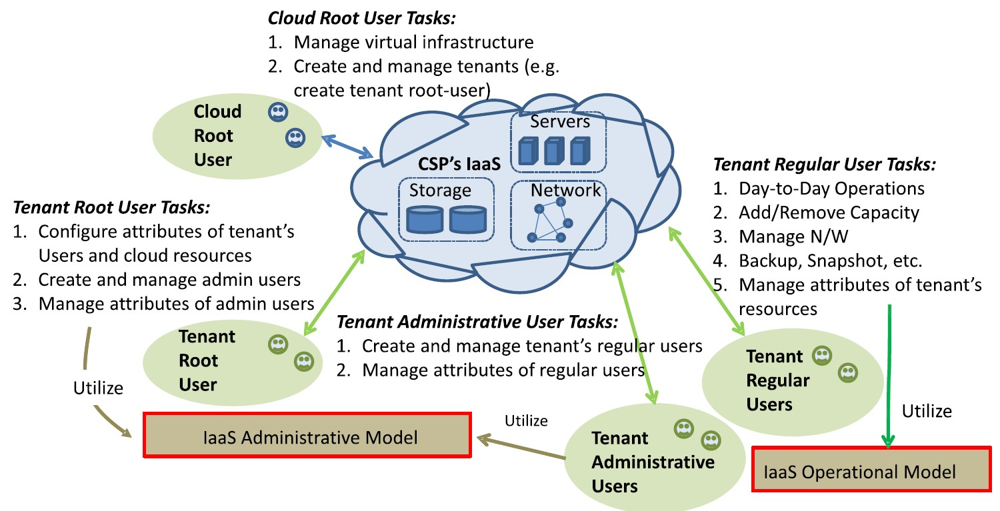
Access Control in IaaS
World-Leading Research with Real-World Impact!
6
Notes:
Take the CS department migration as example
All types of users first
What is used to control their actions
How does this policy be configured

Slide 7
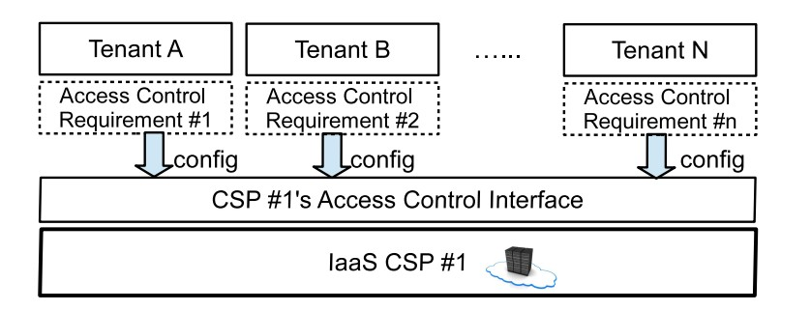
Requirements: Intra-CSP
World-Leading Research with Real-World Impact!
7
Notes:
1. Tenant control their own

Slide 8
Requirements: Inter-CSP
World-Leading Research with Real-World Impact!
8
Notes:
UCON 2004

Slide 9
Key Requirements
Requirements
Tenants’ full control over their access control design
Simple yet flexible administrative policy
Flexible operational model
Strong formal foundations
Existing Models
Industry Models
OpenStack and Amazon Web Service
RBAC-based Models
Using the legend RBAC model
ABAC-based Models
More details to follow
World-Leading Research with Real-World Impact!
9
Notes:
UCON 2004

Slide 10
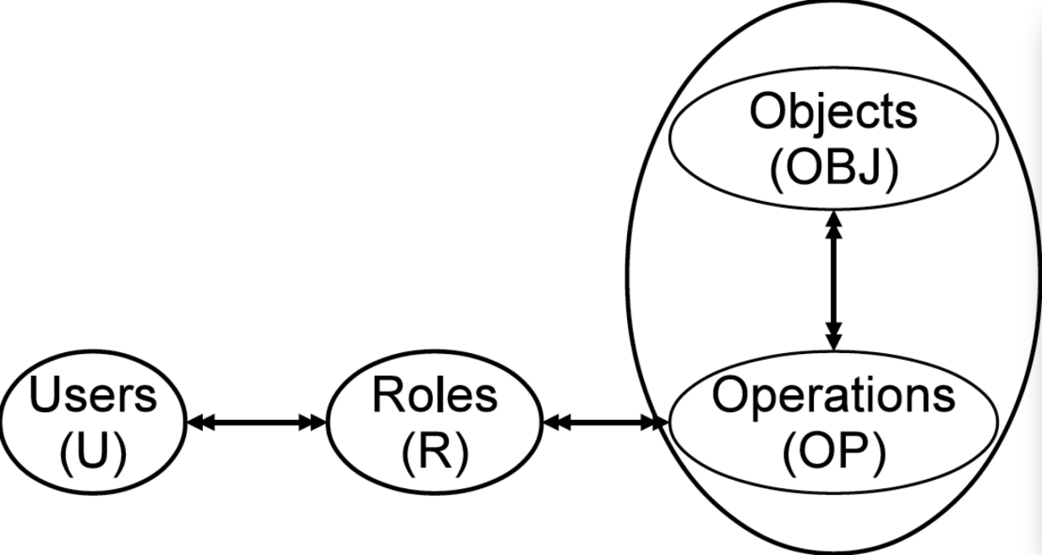
OpenStack (Grizzly Release)
Limitations
Tenant can not configure their own policy, uses cloud role instead
Not able to configure tenant administrator
Access control on operation level, no control on object level
Give identity:createUser permission to role r1, then r1 can create users in any tenant
Give nova:stop permission to role r1, r1 can stop any machine in the tenant
Access control only based on role
World-Leading Research with Real-World Impact!
10

Slide 11
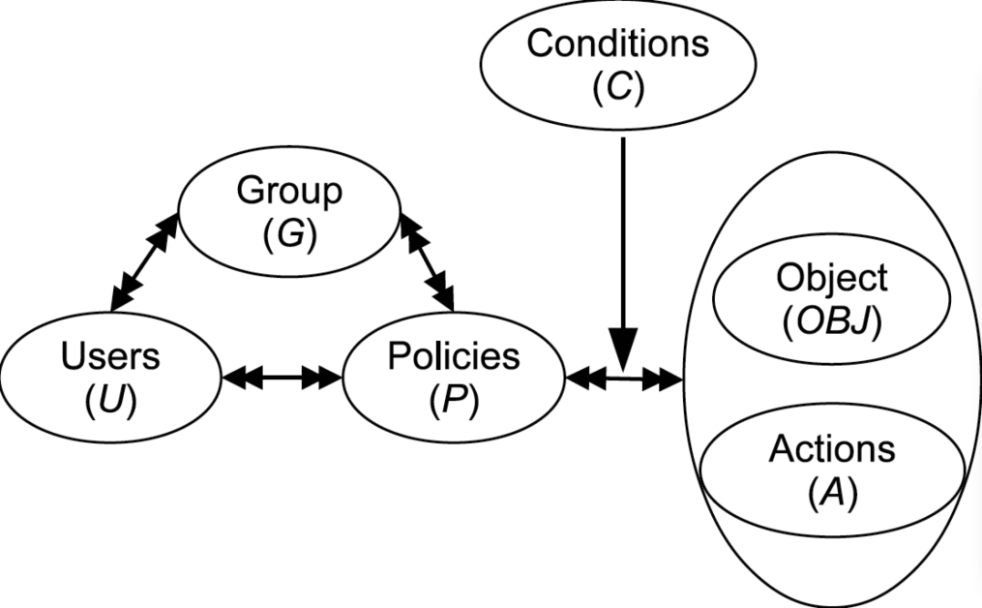
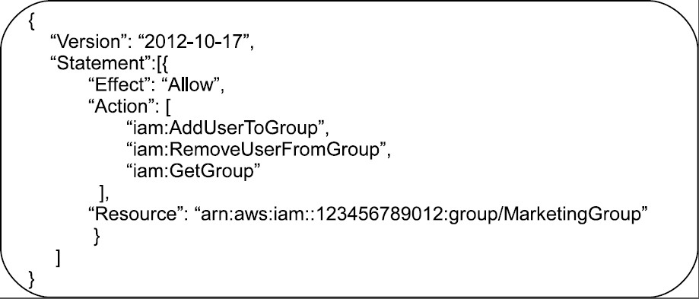
AWS Access Control
World-Leading Research with Real-World Impact!
11
Notes:
Emphasize concept of account

Slide 12
AWS Access Control
Advantages over OpenStack
Tenant has full control over their own policy, by account root user
Flexible policy : groups, user id, time, address.
Control over resources and operations
Limitations
No automation
Restricted set of attributes
Not flexible enough, group explosion
No extension available (e.g., can not include customized attributes)
No subject and user distinction
World-Leading Research with Real-World Impact!
12

Slide 13
Related ABAC models
Formal Model
UCONABC (Park and Sandhu, 01): authorization, mutable attributes, continuous enforcement
Logical framework (Wang et al, 04): set-theory to model attributes
NIST ABAC draft (Hu et al, 13): enterprise enforcement
Policy Specification Language
SecPAL (Becker et al 03, 04), DYNPAL (Becker et al 09), Rule-based policy (Antoniou et al, 07), Binder (DeTreville 02) , EPAL1.2 (IBM, 03) , FAF (Jajodia et al 01)
Enforcement Models
ABAC for web service (Yuan et al 06), PolicyMaker (Blaze et al 96)
Implementations
XACML: authorization
SAML: pass attributes
OAuth: authorization
Attribute Based Encryption
KP-ABE (Goyal et al 06), CP-ABE (Bethencourt et al 07)
No difference between user and subject (classical models can not be configured)
No relationship of user, subject and object attributes.
Focus on authorization and attribute release among organizations
Limited Policy Language
World-Leading Research with Real-World Impact!
13
Notes:
Based on the assumption that users and objects are associated with certain sets of attributes, the
Following works exists:
NIST ABAC: enprisize enforcement such as
SecPAL: SecPAL: Design and semantics of a decentralized authorization language.
^{Policies and credentials} are defined in logical clause
DYNPAL: with updating of system
Rule based policy: include statement of credential and action
Binder: open logic based security language specifies attributes communications among parties.
EPAL: enterprise privacy authorization language
FAF: predicate and support inference
Key-Policy Attribute-Based Encryption: extends the above work to associate policy tree instead of lists of attributes with private keys
Cp-abe: on the other hand enables encryptor to associate policy trees with ciphertext
^{Say limitations at the end}

Slide 14
Proposed Model
ABAC-alpha model [1] and GURA model [2]
Flexibility
Covers DAC, MAC and RBAC
Potentials to covers various RBAC extensions
Resource-level fine-grained access control
Automation
User attributes inherited by subject and further object, access control automatically added for newly created objects
Ease in policy specification and administration
Attributes defined to reflect semantic meaning and policy specified with certain level of relationship to natural language
[1] Xin Jin, Ram Krishnan and Ravi Sandhu, A Unified Attribute-Based Access Control Model Covering DAC, MAC and RBAC In Proceedings 26th Annual IFIP WG 11.3 Working Conference on Data and Applications Security and Privacy DBSec 2012.
[2] Xin Jin, Ram Krishnan and Ravi Sandhu, A Role-Based Administration Model for Attributes. In Proceedings of the First ACM International Workshop on Secure and Resilient Architectures and Systems (SRAS '12), Minneapolis, Minnesota, September 19, 2012
World-Leading Research with Real-World Impact!
14

Slide 15
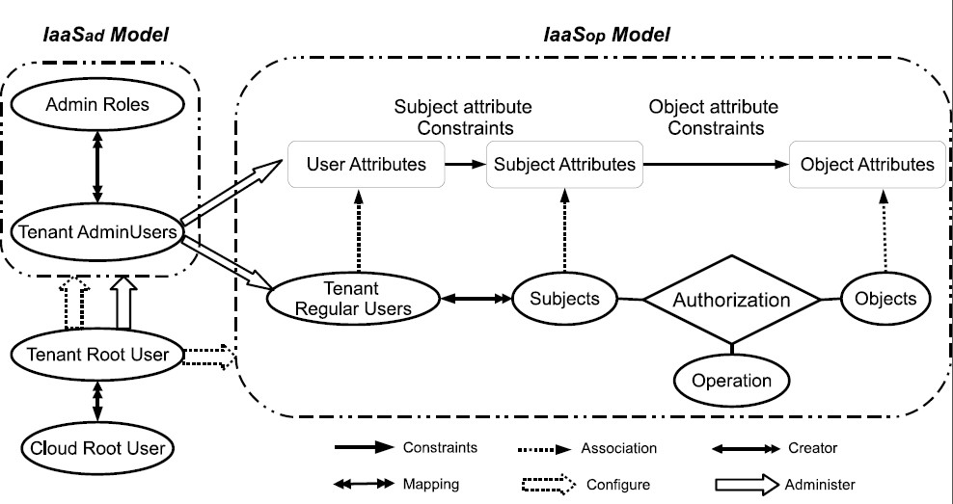
IaaSad and IaaSop Model
Different types of object may have different sets of attributes.
World-Leading Research with Real-World Impact!
15

Slide 16
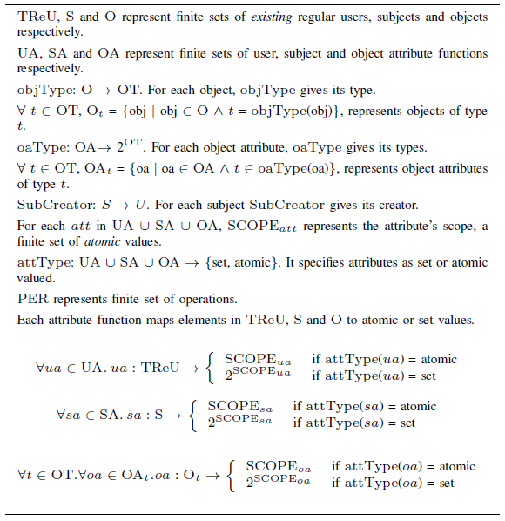
IaaSop Model

Slide 17
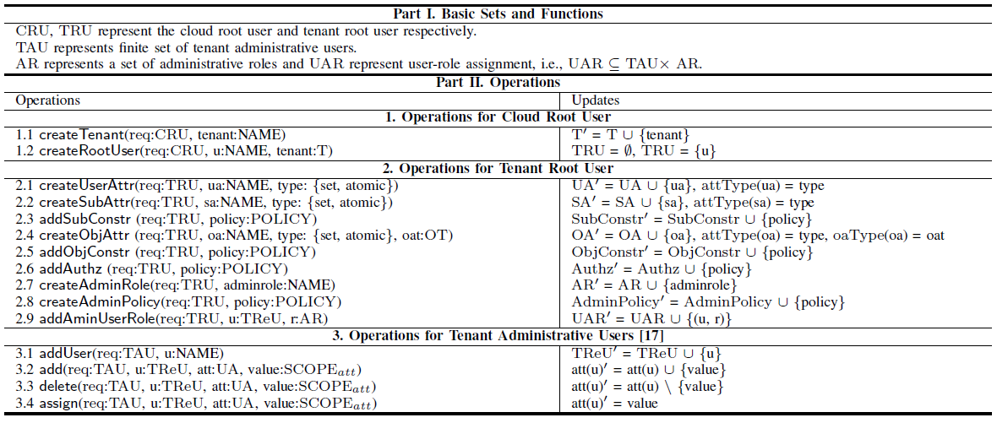
IaaSad Model

Slide 18
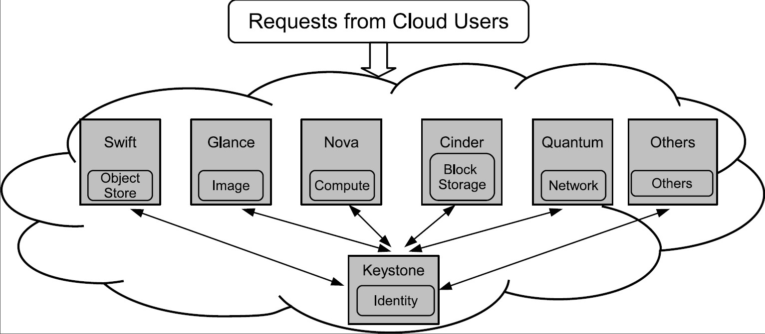
Proof of concept in OpenStack
World-Leading Research with Real-World Impact!
18

Slide 19
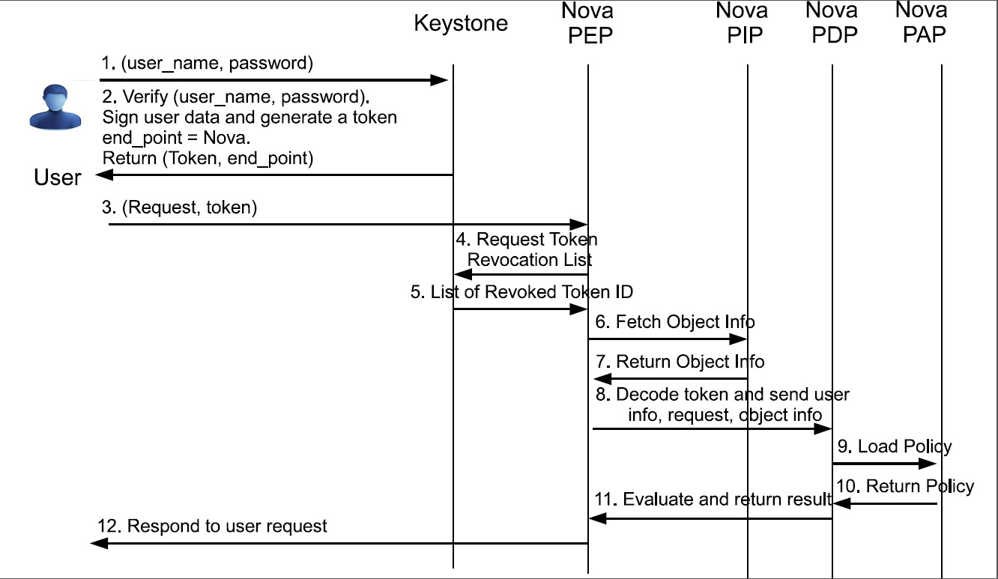
OpenStack Authorization for Nova
World-Leading Research with Real-World Impact!
19
Notes:
What is a token and how is it generated?

Slide 20
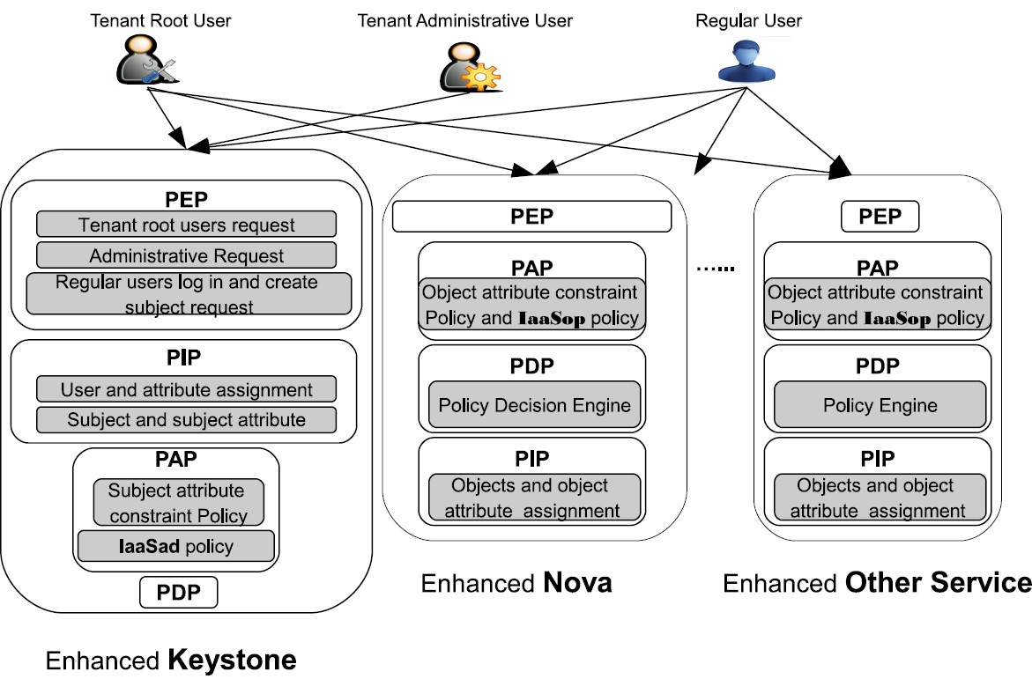
ABAC Enforcement in OpenStack
Enforcement Model I
World-Leading Research with Real-World Impact!
20

Slide 21
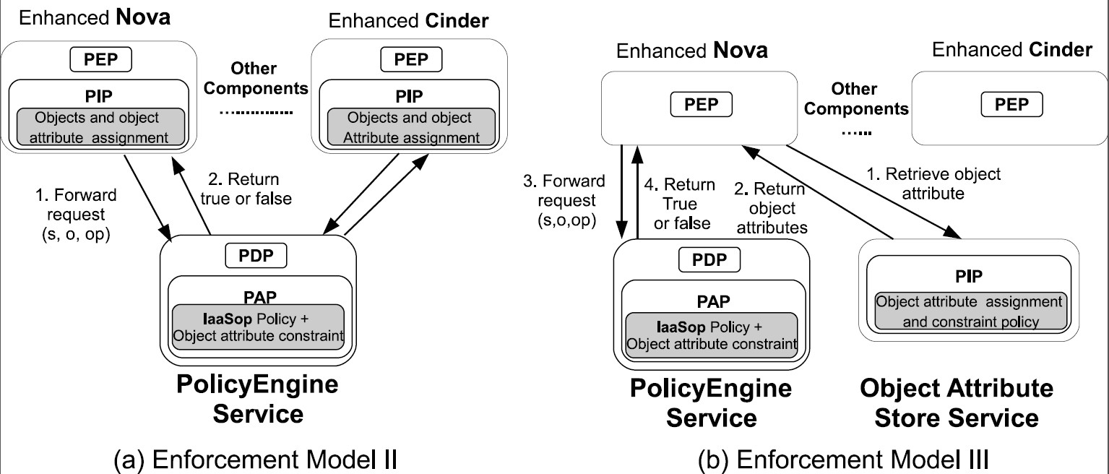
Alternative Enforcement Models
World-Leading Research with Real-World Impact!
21

Slide 22
Conclusion
Summary
We illustrate the case of access control in cloud IaaS
We summarize four core requirements of access control models
Existing models fail to satisfy those requirements
By connecting existing models with additional features, we proposed IaaSop and IaaSad models based on ABAC
Future work
Different types of attributes: system wide, service-specific attributes.
Various types of subject attributes constraints, object attribute constraints.
Reachability analysis on IaaSop and IaaSad instance.
World-Leading Research with Real-World Impact!
22

Slide 23
Conclusion
Thanks. Questions?
World-Leading Research with Real-World Impact!
23

