Slide 1
A Model for the Administration of Access Control in Software Defined Networking using Custom Permissions
Abdullah Al-Alaj¹, Ravi Sandhu¹ and Ram Krishnan² ¹Dept. of Computer Science ²Dept. of Electrical and Computer Engineering ^{1,2}Institute for Cyber Security ^{1,2}Center for Security and Privacy Enhanced Cloud Computing (C-SPECC) University of Texas at San Antonio, TX 78249 The Second IEEE International Conference on Trust, Privacy and Security in Intelligent Systems, and Applications (TPS-ISA 2020) December 2, 2020

Slide 2
Agenda
Motivation
Access Control Administration in SDN
SDN-RBACa Administrative Model
Custom and Proxy Operations
Custom Permissions
Task and Role Engineering Custom Permissions
Use-Case and Administrative Actions
Evaluation and Comparison
Conclusion and Future Work

Slide 3
Motivation
RBAC has been applied in SDN.
RBAC simplifies the administration of authorizations.
Currently, role-based approaches for SDN are lacking such administrative model.
Operations provided by SDN services are coarse grained.
Extend the capabilities of SDN services and provide fine grained custom permissions.

Slide 4
Administrative Units in SDN
Small SDN networks could be managed by a single administrator or a single admin unit.
Larger SDNs become more complex to centrally manage all access control associations by a single administrative authority.
Administration has to be decentralized into multiple AUs.
Assigned to
Admin Unit
Assigned to
Admin User
Admin User
Manages Portion of
Can Manage
Can Manage
Apps
Roles
Tasks
App-role
assignment
Task-role
assignment

Slide 5
Access Control Administration in SDN
App-role and permission-role relations need management.
In SDN-RBACa administrative model.
Indirect permission-role assignment.
Permissions are grouped into permission-pools (tasks).
Tasks: units of network functions.
Apps are grouped into app-pools.
Administrative Units for administering app-role and task-role relations.
Assigned to
Admin Unit
Assigned to
Admin User
Admin User
Manages Portion of
Can Manage
Can Manage
Apps
Roles
Tasks
App-role
assignment
Task-role
assignment

Slide 6
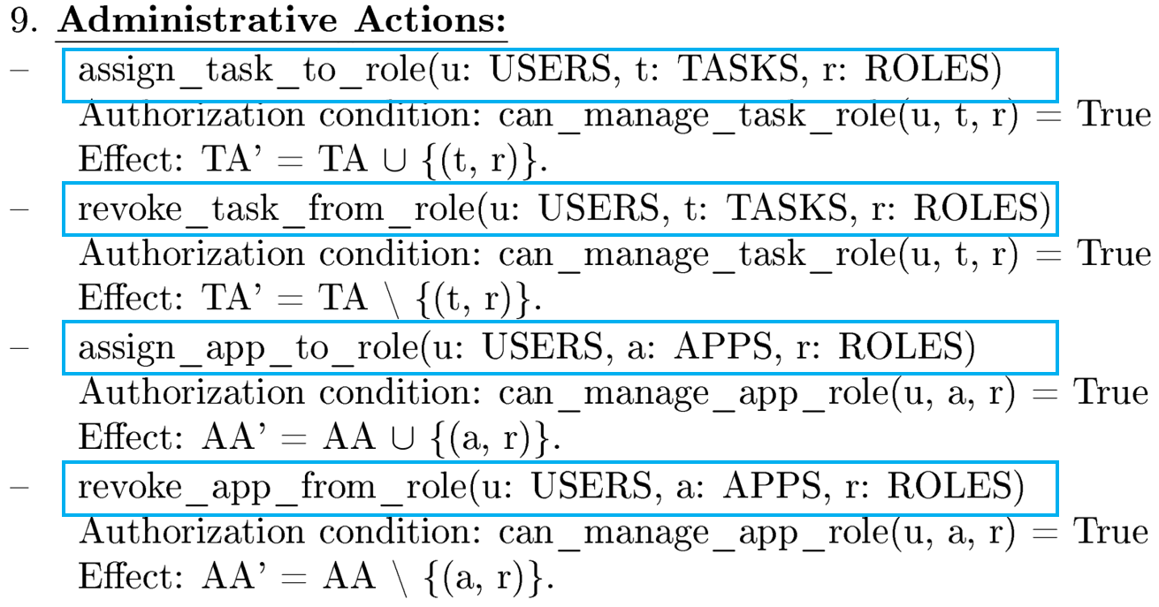
SDN-RBACa Administrative Model (Conceptual)
.

Slide 7
SDN-RBACa Administrative Model (Conceptual)
.

Slide 8
SDN-RBACa Administrative Model Defenition

Slide 9
Use Case using SDN-RBACa - Motivation
In large SDNs, specialized apps control/analyze and monitor/inspect specific network traffic type.
These apps should be authorized to access only traffic type they handle and not other type (via roles).
Apps
Roles
Required, but not available
Web-specific apps:
Web Load Balancers
Web Firewalls
etc.
VoIP-specific apps:
VoIP Load Balancers
VoIP Firewalls
etc.
FTP-specific apps:
FTP Load Balancers
FTP Firewalls
etc.
Email-specific apps:
Email Load Balancers
Email Firewalls
etc.
Web-specific roles:
Web Flow Mod
Web Load Balancing
etc.
VoIP-specific roles:
VoIP Flow Mod
VoIP Load Balancing
etc.
FTP-specific roles:
Ftp Flow Mod
Ftp Load Balancing
etc.
Email-specific roles:
Email Flow Mod
Email Load Balancing
etc.
Authorized via
Authorized via
Authorized via
Authorized via

Slide 10
Use Case using SDN-RBACa - Motivation
In large SDNs, specialized apps control/analyze and monitor/inspect specific network traffic type.
These apps should be authorized to access only traffic type they handle and not other type (via roles).
Apps
Roles
Existing, but problematic
Web-specific apps:
Web Load Balancers
Web Firewalls
etc.
VoIP-specific apps:
VoIP Load Balancers
VoIP Firewalls
etc.
FTP-specific apps:
FTP Load Balancers
FTP Firewalls
etc.
Email-specific apps:
Email Load Balancers
Email Firewalls
etc.
Roles:
Flow Mod
Load Balancing
etc.
Authorized via
?
Authorized via
Authorized via
Authorized via

Slide 11
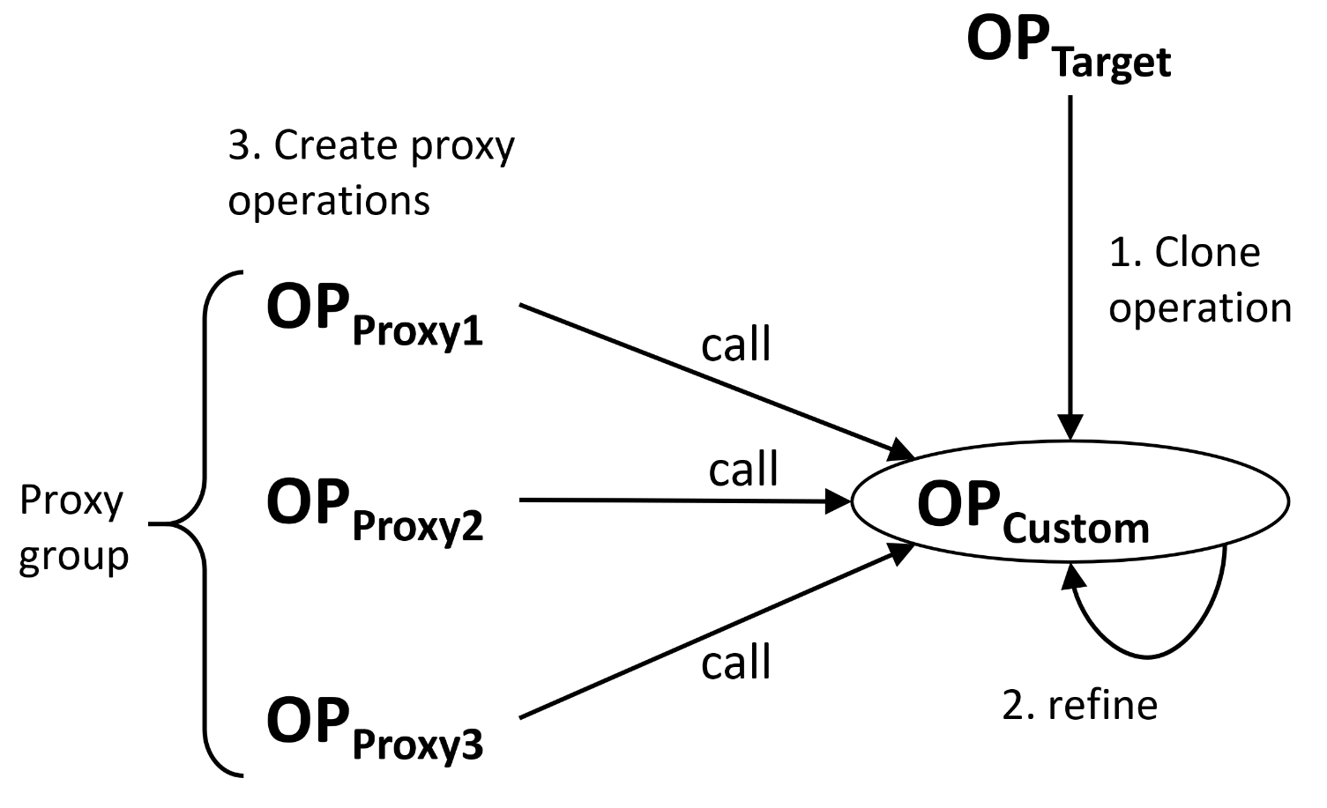
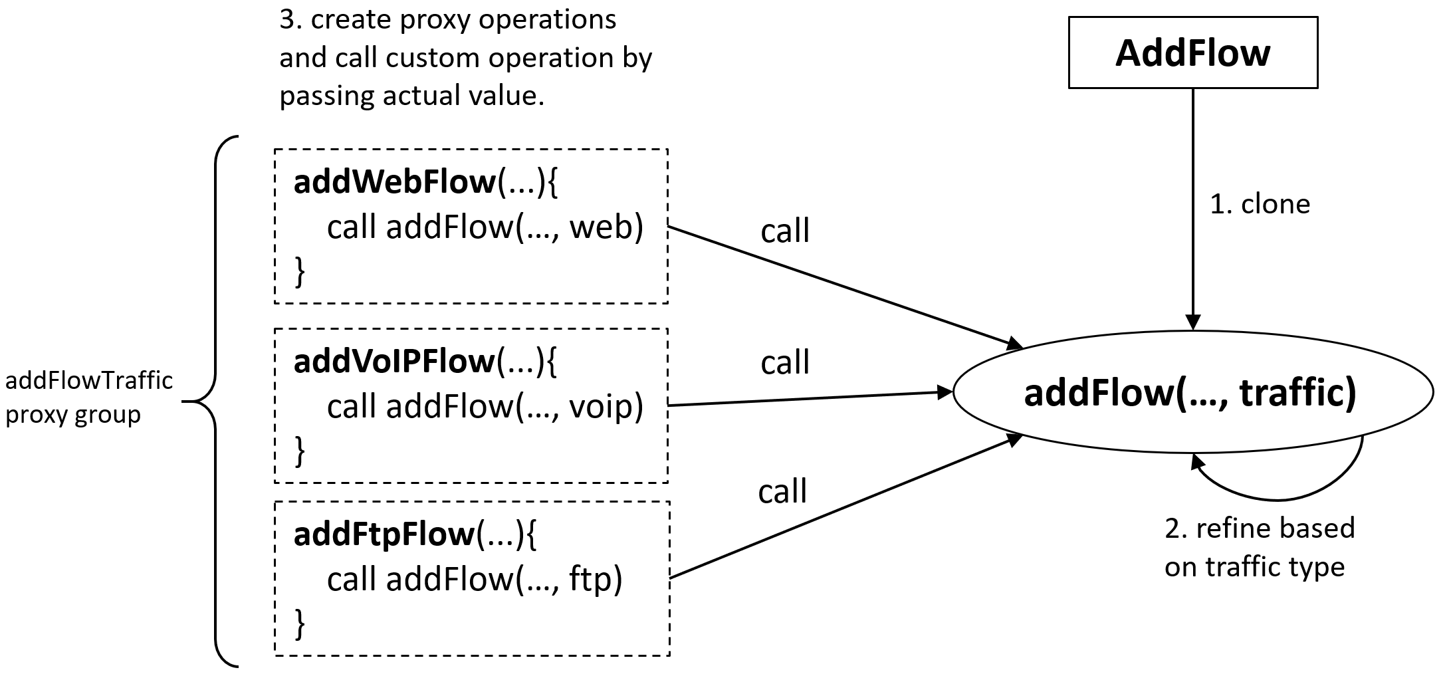
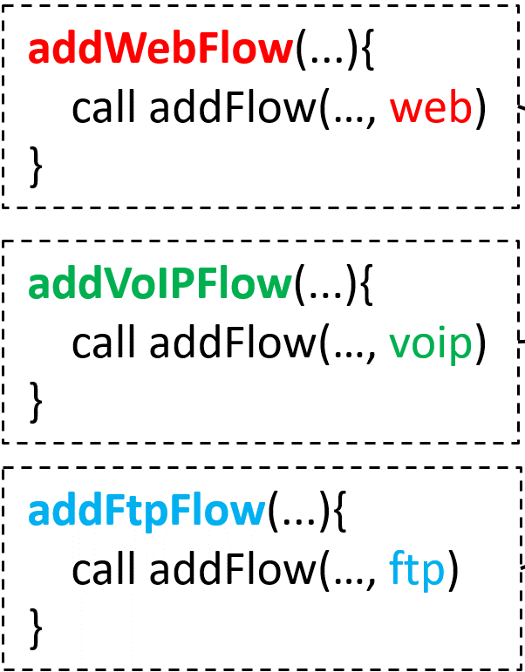
Custom and Proxy Operations
OP_{Proxy1}
OP_{Proxy2}
OP_{Proxy3}
(verify access to appropriate content)
provides restrictive access to specific traffic type.
(ensure that flow rule handles correct traffic type)

Slide 12
Custom Permissions
Custom permissions are those permissions that are created using proxy operations.
(OP_{Proxy_1}, ot)
(OP_{Proxy_2}, ot)
(OP_{Proxy_3}, ot)
…
A permission
created using target operation.
Custom permissions
created using proxy operations:
(addWebFlow, FLOW-RULE)
(addVoIPFlow, FLOW-RULE)
(addFtpFlow, FLOW-RULE)
(createWebMember, LB-POOL-MEMBER)
(createVoIPMember, LB-POOL-MEMBER)
(createFtpMember, LB-POOL-MEMBER)
(readWebPacketInPayload, PI-PAYLOAD)
(readVoIPPacketInPayload, PI-PAYLOAD)
…
(addFlow, FLOW-RULE)

Slide 13
Task and Role Engineering using Custom Permissions - Example
SDN Apps
Roles
Tasks
Custom
Permissions
OP_{Proxy}
OP_{Custom}
OP_{Target}
(addWebFlow, FlOW-RULE)
Web Traffic Forwarding Task
(addWebFlow, FlOW-RULE)
Web Traffic Forwarding Task
addWebFlow
addWebFlow
web
Web Intrusion Prevention
web
Web Intrusion Prevention
Web Flow Mod
Web Flow Mod
(addVoipFlow, FlOW-RULE)
voip
clone
addFlow
addVoipFlow
addFlow(traffic)
Web Flow Viewing Task
ftp
Web Flow Viewing Task
(addFtpFlow, FlOW-RULE)
addFtpFlow
passed to custom operation
(deleteWebFlow, FlOW-RULE)
VoIP Traffic Forwarding Task
(deleteWebFlow, FlOW-RULE)
deleteWebFlow
deleteWebFlow
web
VoIP Load Balancer
web
VoIP Flow Mod
(deleteVoipFlow, FlOW-RULE)
voip
clone
deleteFlow
deleteVoipFlow
deleteFlow(traffic)
Voip Flow Viewing
ftp
(deleteFtpFlow, FlOW-RULE)
deleteFtpFlow
(readWebFlow, FlOW-RULE)
FTP Traffic Forwarding Task
(readWebFlow, FlOW-RULE)
readWebFlow
readWebFlow
web
web
FTP Application Firewall
FTP Flow Mod
(readVoipFlow, FlOW-RULE)
voip
clone
readFlow
readVoipFlow
readFlow(traffic)
FTP Flow Viewing Task
ftp
(readFtpFlow, FlOW-RULE)
readFtpFlow

Slide 14
Roles Engineered after using Custom Permissions
In large SDNs, specialized apps control/analyze and monitor/inspect specific network traffic type.
These apps should be authorized to access only traffic type they handle and not other type (via roles).
Apps
Roles
Required, and available
Web-specific apps:
Web Load Balancers
Web Firewalls
etc.
VoIP-specific apps:
VoIP Load Balancers
VoIP Firewalls
etc.
FTP-specific apps:
FTP Load Balancers
FTP Firewalls
etc.
Email-specific apps:
Email Load Balancers
Email Firewalls
etc.
Web-specific roles:
Web Flow Mod
Web Load Balancing
etc.
VoIP-specific roles:
VoIP Flow Mod
VoIP Load Balancing
etc.
FTP-specific roles:
Ftp Flow Mod
Ftp Load Balancing
etc.
Email-specific roles:
Email Flow Mod
Email Load Balancing
etc.
Authorized via
Authorized via
Authorized via
Authorized via

Slide 15
Functional Administrative Units for SDN
Relations between apps and roles should be managed by different administrative units.
Administrative Units
Roles: {Web Flow Mod, Web Load Balancing, etc.}
App-Pools: {Web Security, Web Load Balance, etc.}
Roles: {Email Flow Mod, Email Load Balancing, , etc.}
App-Pools: {Email Security, Email Load Balance}
Roles: {Email Flow Mod, VoIP Load Balancing, etc.}}
App-Pools: {VoIP Security, VoIP Load Balance}
Roles: {FTP Mod Email, FTP Load Balancing, etc.}
App-Pools: {FTP Security, FTP Load Balance}
Web Admin Unit
Email Admin Unit
VoIP Admin Unit
FTP Admin Unit

Slide 16
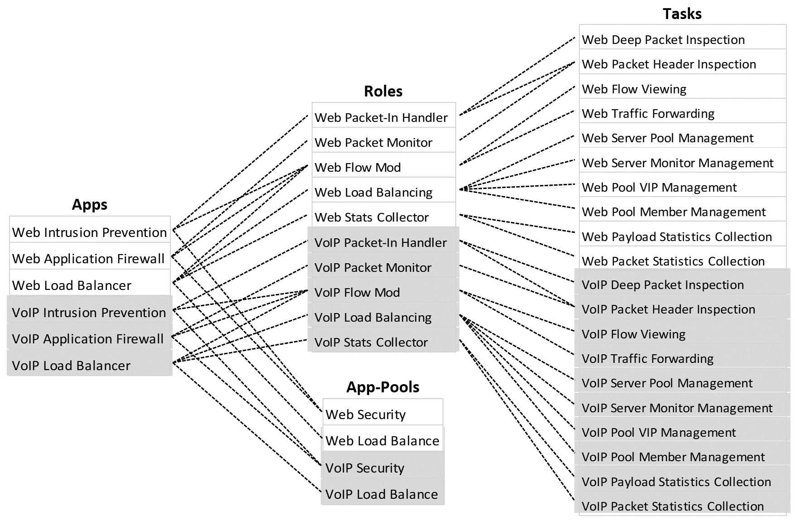
Use-Case and Administrative Actions
Tasks, roles, and app-pools in white are exclusively managed by:
Tasks, roles, and app-pools in gray are exclusively managed by:
Web Admin Unit
VoIP Admin Unit
Administrative User Assignment:
TA_admin = {
(web_functions_admin_user, Web Admin Unit),
(voip_functions_admin_user, VoIP Admin Unit)}.
Example:
1. Administrative Action to assign task to a role:
assign_task_to_role(web_functions_admin_user, Web Traffic Forwarding Task, Web Flow Mod) is allowed.
→Authorization Function:
can_manage_task_role(web_functions_admin_user, Web Traffic Forwarding Task, Web Flow Mod) = True.
Reason:
∃Web Admin Unit ∈ AU : ((web_functions_admin_user, Web Admin Unit) ∈ TA_admin) ∧
Web Flow Mod ∈ roles(Web Admin Unit) ∧
Web Traffic Forwarding Task ∈ tasks(Web Admin Unit).

Slide 17
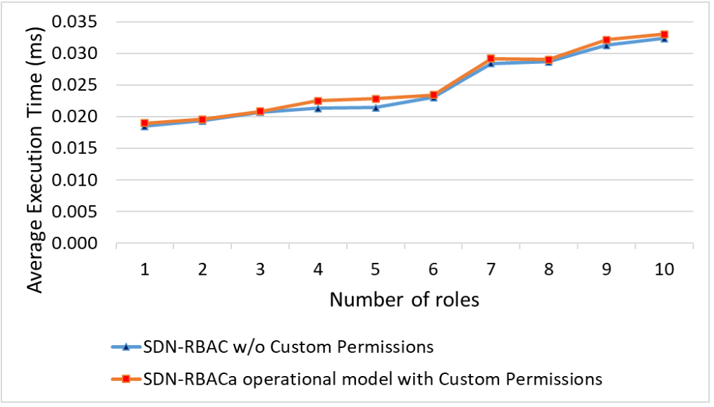
Evaluation and Comparison
Evaluation of SDN-RBACa operational model with tasks and proxy permissions.
Test app with 50 proxy operations ops covered by 10 different roles.
Report authorization time for all 50 requests.
Different security policies.
Test repeated 100 times for each security policy.
Average authorization time is calculated.
Overhead of around 2.9% on average to the authorization framework.

Slide 18
Conclusion and Future Work
This work presented SDN-RBACa, an administrative model for role based access control in SDN.
An approach to extend the capabilities of SDN services for creating custom SDN permissions specialized for the administration of access control in SDN.
Through proof of concept prototype implementation and use cases, we demonstrated the usability of custom permissions.
In future work, custom permissions can be further refined and demonstrated in more use cases and implementations of the administrative model.

Slide 19
Thank you

